Slide 1
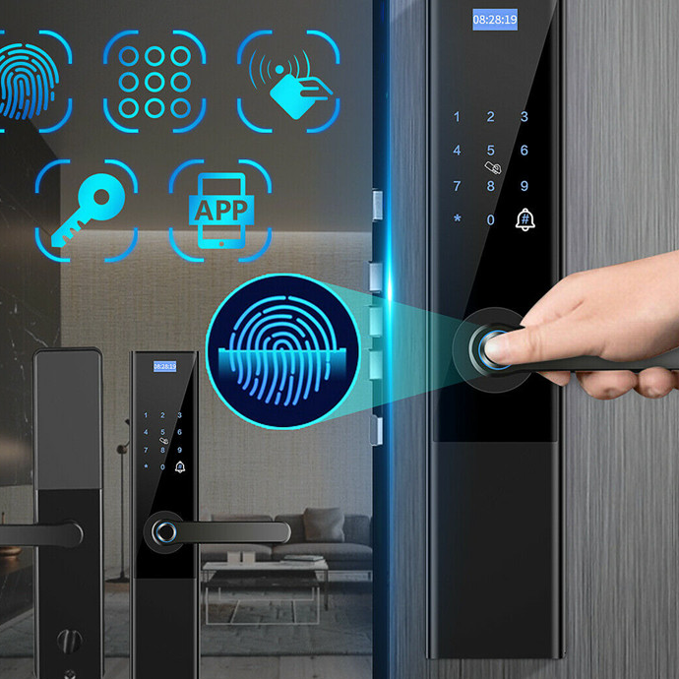
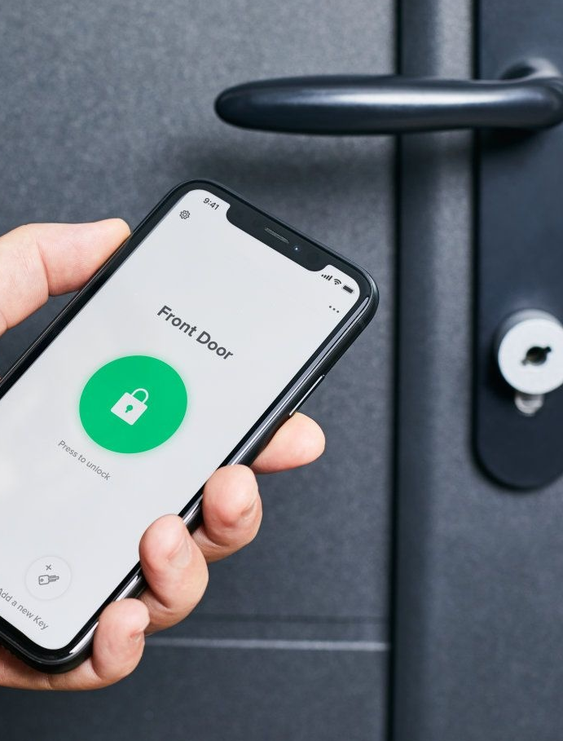
SMART DOOR
Lecturer : Lê Trung Quân
Course: Advanced Internet of Things Technologies
NT532.L11.MMCL
Group 2
Võ Thanh Vân – 17521251
Nguyễn Trí Tâm - 17521006

Slide 2

Overview
MQTT protocol
Hardware
Software
Demo
About Us

Slide 3
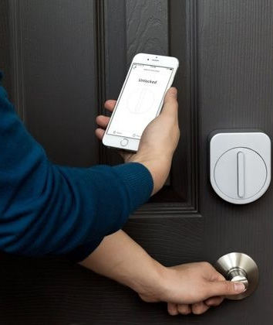
OVERVIEW
Currently, smart homes in general and smart doors in particular are used quite commonly in apartments and resorts. But most of them use magnetic cards mainly, which leads to easy loss of cards and makes it difficult to enter the house.
So, my group did the topic of smart doors using smart phones to open them. By using Telegram and Facebook apps. Because according to statistics by June 2020, there are 69,280,000 Facebook users in Vietnam.
So the group sees the feasibility of this topic and decides to implement it.

Slide 4

WHAT IS MQTT
MQTT is an open OASIS and ISO standard lightweight, publish-subscribe network protocol that transports messages between devices. The protocol usually runs over TCP/IP; however, any network protocol that provides ordered, lossless, bi-directional connections can support MQTT.

Slide 5
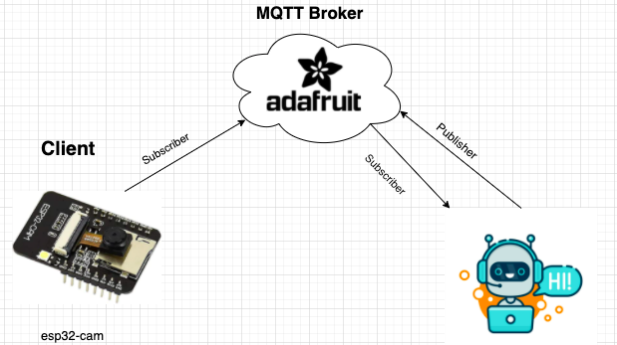
MQTT IN TOPIC
Here we use adafruit.io as the broker server. And the esp device will keep role as a subscriber that will receive messages sent from the server to control the device and publish about device's status.
The facebook chat bot will play both roles as publisher and subscriber to send control messages and receive feedback about the device's status.

Slide 6

HARDWARE

Slide 7
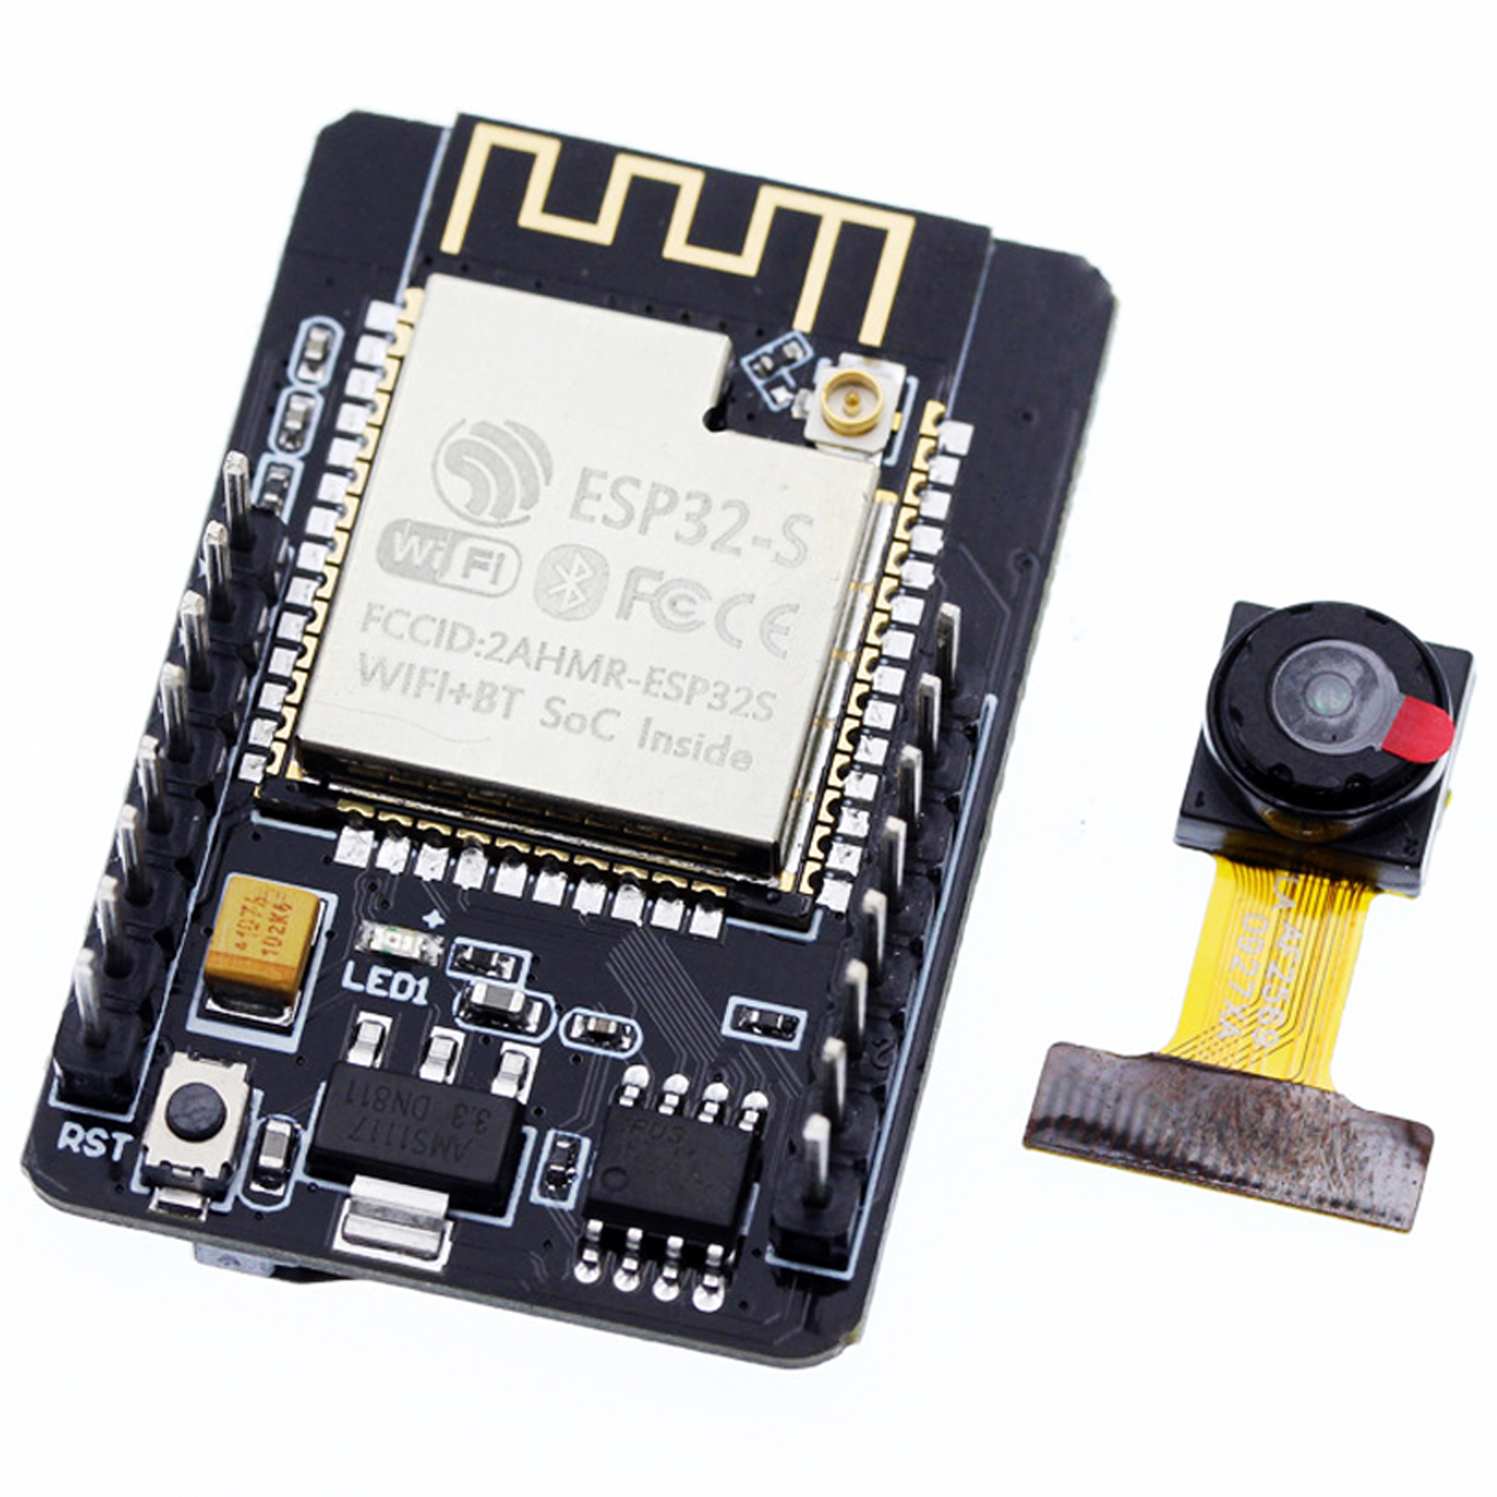
ESP32 CAM
Supports UART/SPI/I2C/PWM/ADC/DAC
Support OV2640 and OV7670 cameras, built-in flash lamp
Support image WiFI upload
Support TF card
Supports multiple sleep modes
Embedded Lwip and FreeRTOS
Supports STA/AP/STA+AP operation mode
Support Smart Config/AirKiss technology
Support for serial port local and remote firmware upgrades (FOTA)

Slide 8
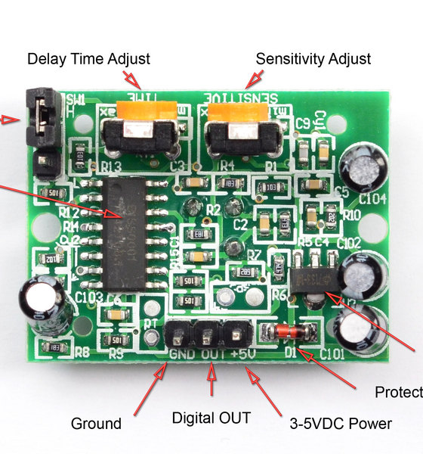
PIR SENSOR
Wide range on input voltage varying from 4.V to 12V (+5V recommended)
Output voltage is High/Low (3.3V TTL)
Can distinguish between object movement and human movement.
Has to operating modes - Repeatable(H) and Non- Repeatable(H)
Cover distance of about 120° and 7 meters.
Low power consumption of 65mA.

Slide 9
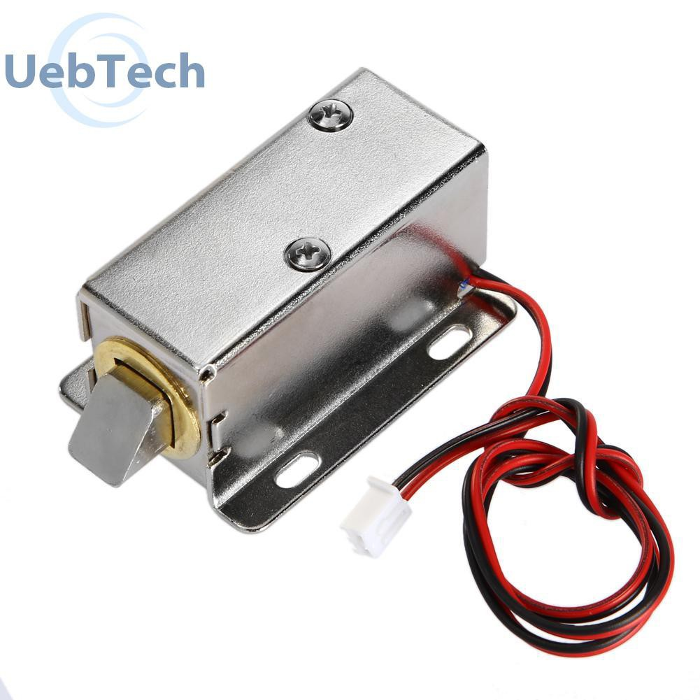
LOCK
Wide range on input voltage varying from 4.V to 12V (+5V recommended)
Output voltage is High/Low (3.3V TTL)
Can distinguish between object movement and human movement.
Has to operating modes - Repeatable(H) and Non- Repeatable(H)
Cover distance of about 120° and 7 meters.
Low power consumption of 65mA.

Slide 10
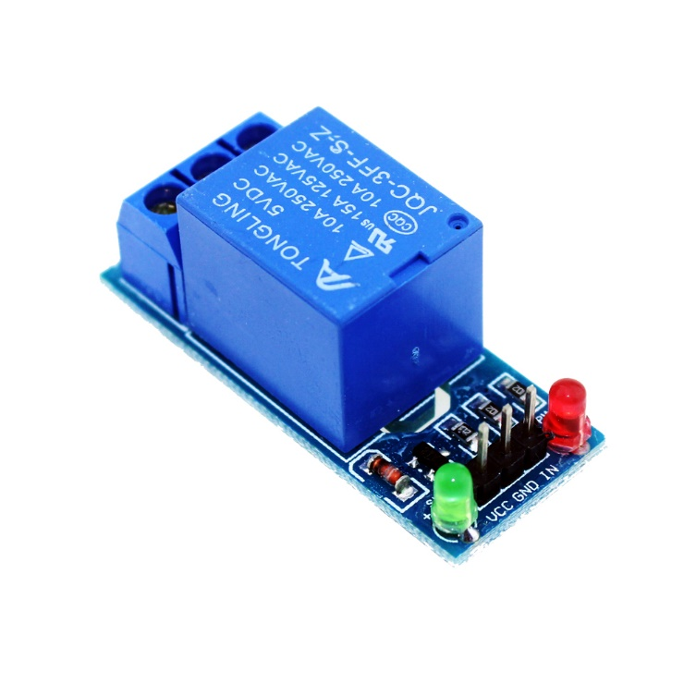
MODULE RELAY
Trigger Voltage (Voltage across coil) : 5V DC.
Trigger Current (Nominal current) : 70mA.
Maximum AC load current: 10A @ 250/125V AC.
Maximum DC load current: 10A @ 30/28V DC.
Compact 5-pin configuration with plastic moulding.
Operating time: 10msec Release time: 5msec.

Slide 11

SOFTWARE

Slide 12





IN PROJECT WE USE

Slide 13

ADAFRUIT
Adafruit.io is a cloud service - that just means we run it for you and you don't have to manage it. You can connect to it over the Internet. It's meant primarily for storing and then retrieving data but it can do a lot more than just that!
Notes:
You can connect to it over the Internet. It's meant to Storing and then retrieving data but it can do a lot more than just that! like :
Display your data in real-time, online
Make your project internet-connected: Control motors, read sensor data, and more!
Connect projects to web services like Twitter, RSS feeds, weather services, etc.
Connect your project to other internet-enabled devices
and it is free

Slide 14
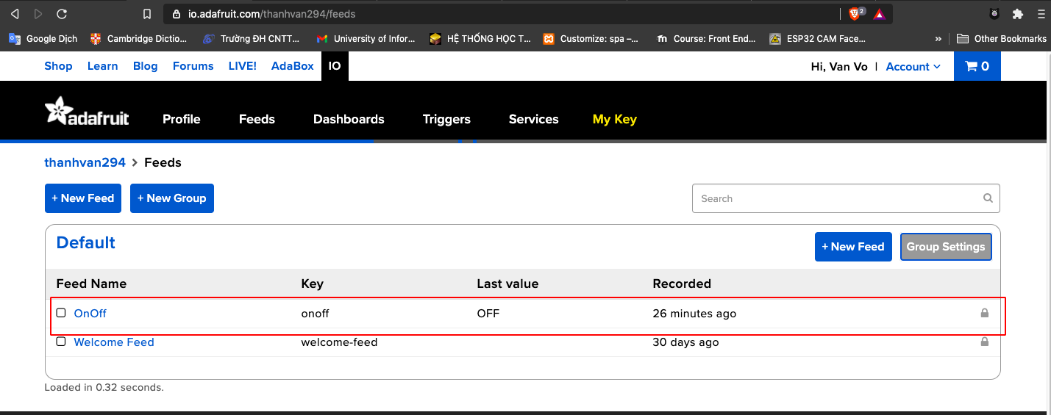
Create feed to display received data
Notes:
To use adafruit to connect to the device via mqtt protocol, we have to create a feed, the feed acts as a topic for it to connect properly with the device.

Slide 15
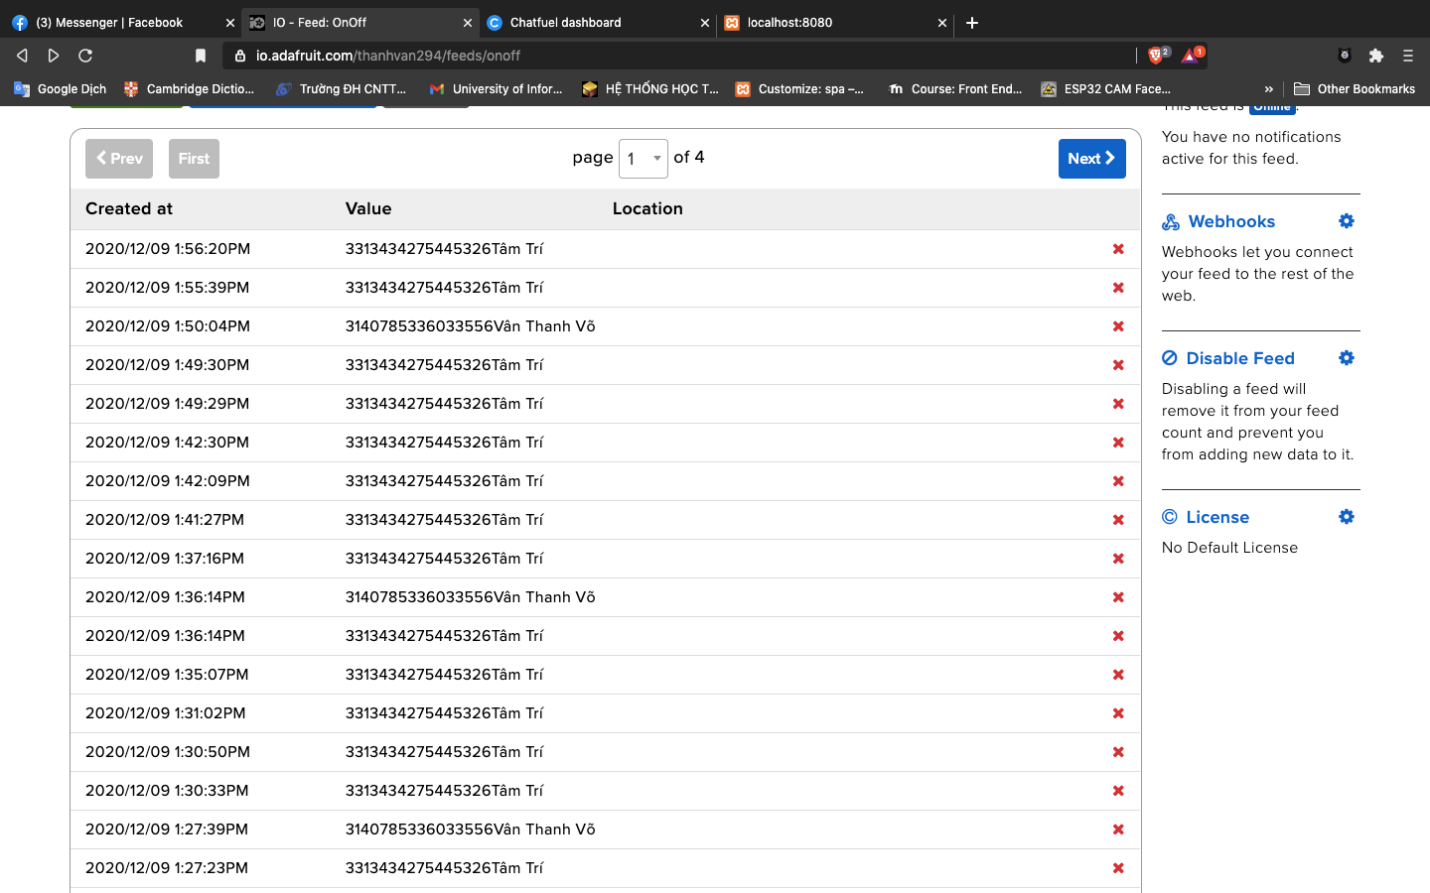
data receice from signal’s facebook mesenger
Notes:
this is log data real-time when you sent signals to adafruit broker. when you sent signals from fb messenger, we did setup to get id and user your fb

Slide 16

CHATFUEL
Chatfuel bots live in Messenger and can be connected to Facebook and Instagram. They can answer questions, recommend products, qualify leads, automate tasks, and perform other functions to benefit your brand. They're ideal for brick-and-mortar businesses, ecommerce retailers, nonprofits, and more.
Notes:
Chatfuel bots live in Messenger and can be connected to Facebook and Instagram. They can answer questions, recommend products, qualify leads, automate tasks... Here, we use it so that it talks to you to control your door locks

Slide 17
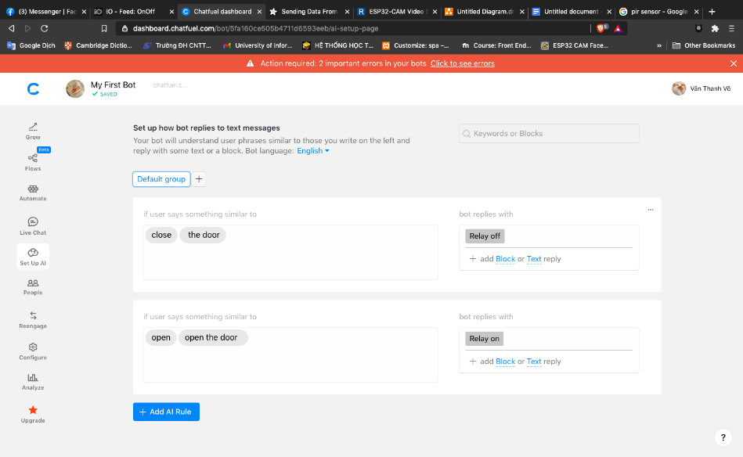
Set up AI data for bot
Notes:
First, we wil set up AI to get key work when user sent messenge to bot, so that the bot can understand that you are trying to open the door or not, if the keyword is correct, it will open

Slide 18
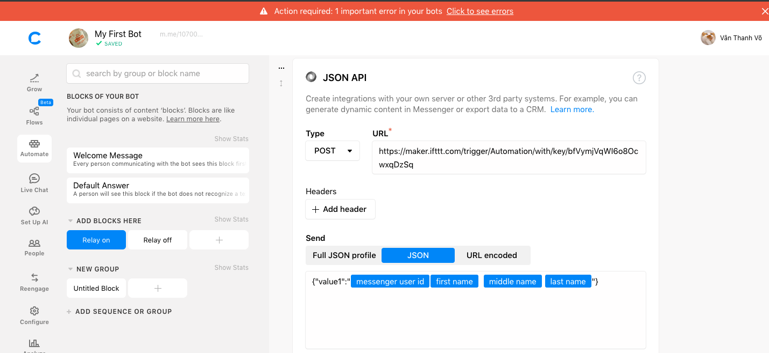
Create event to control door with JSON API from IFTTT
Notes:
Then, we create event to control door with JSON API to sent data to adafruit server

Slide 19

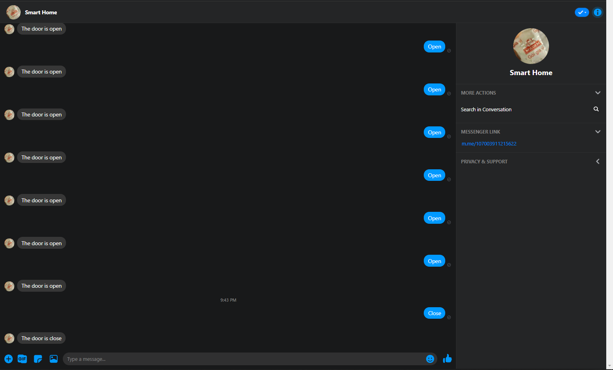
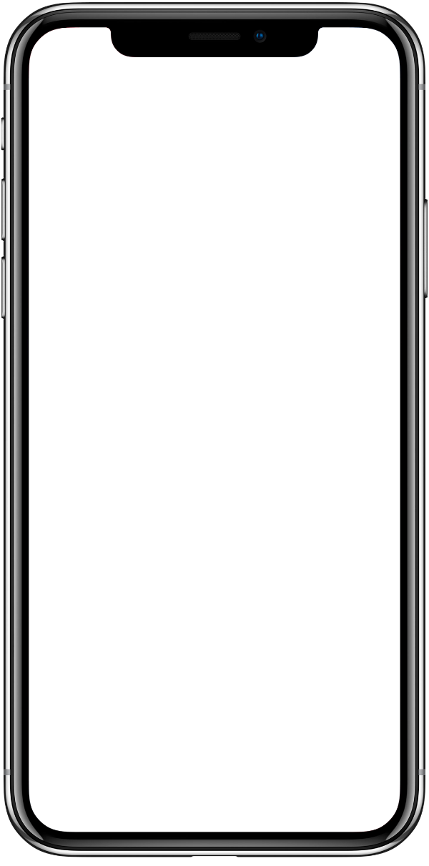
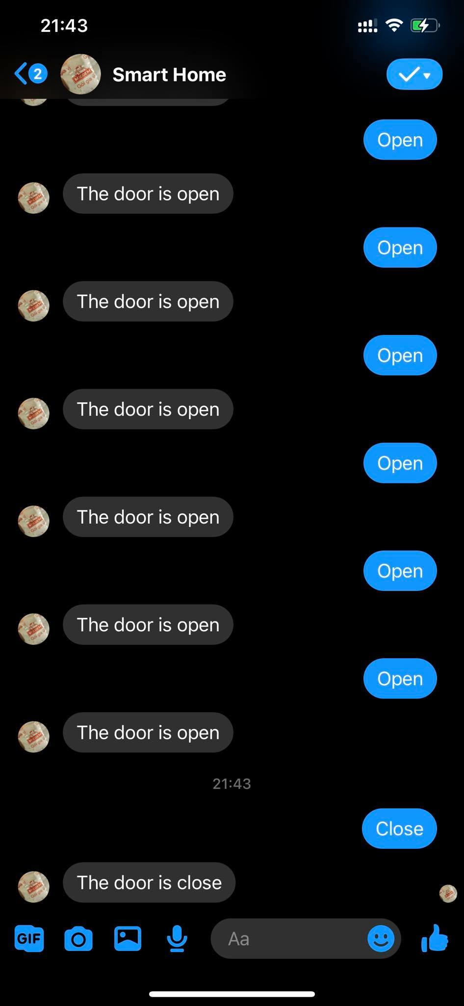
CHECK BOT FACBOOK

Slide 20
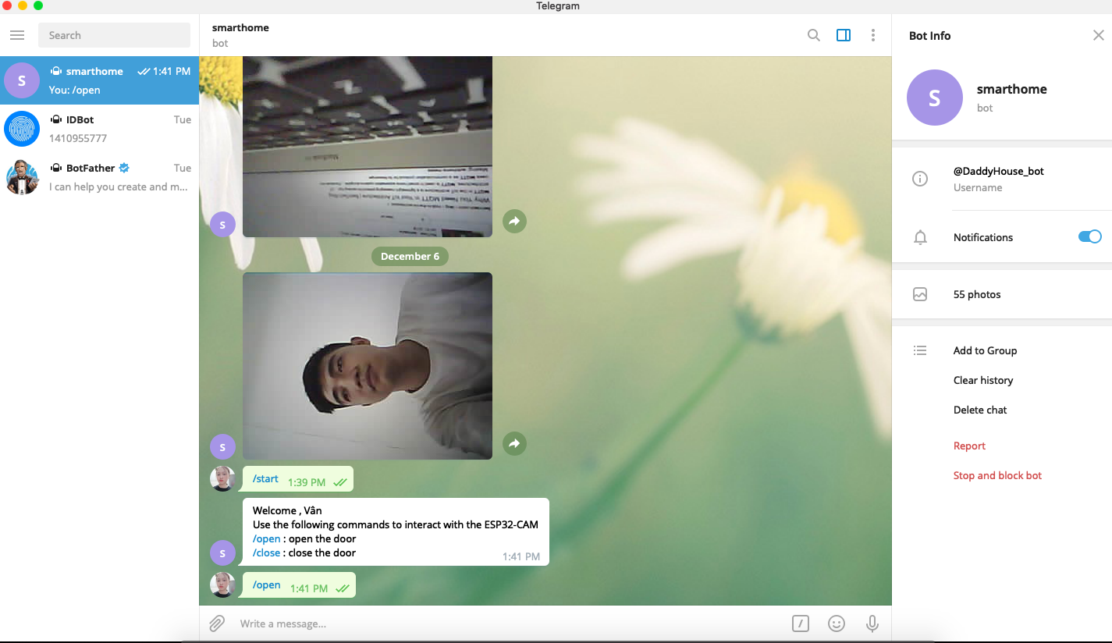
CHECK BOT TELEGRAM
Notes:
And this is the door control with telegram, when someone comes in front of the door, it will take pictures and send them to the telegram. We will control the door open

Slide 21
Webserver

Slide 22
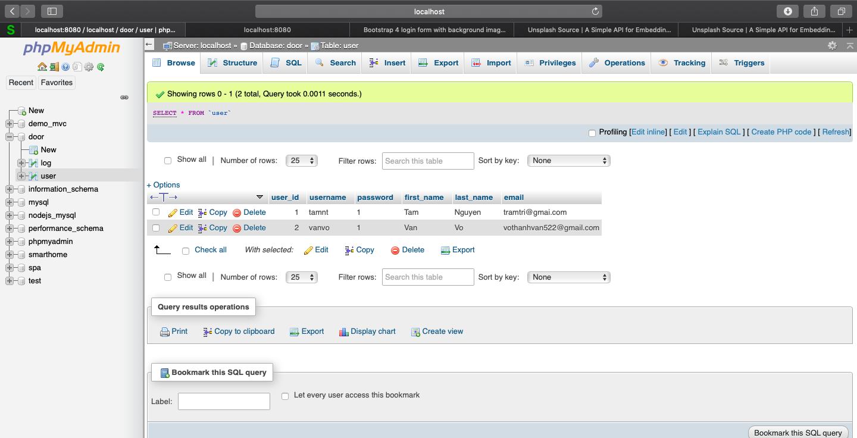
table user
Notes:
Because we control the door by sending messages to the bot, anyone can open the door just text the bot with the correct keywords. So we created a database to make sure that when you have the correct id from fb, the door will open

Slide 23
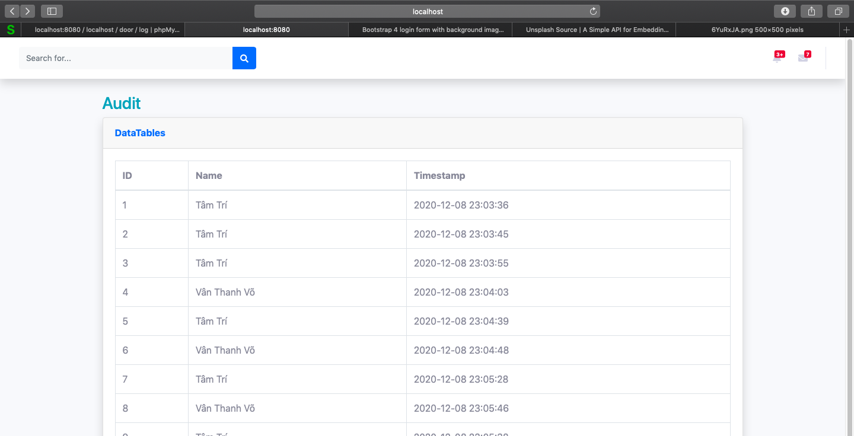
on the webserver there is also a similar table for easy monitoring
Notes:
This is logged info when you open door

